Slide 1
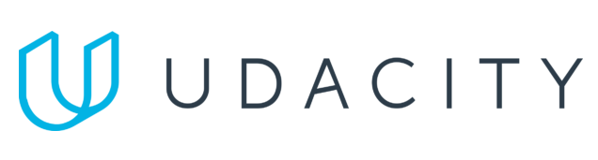
Data Lake Value Proposition
Medical Data Processing Company
CAO HOAI PHUONG
Udacity IPS Version 1.0

Slide 2
Agenda
What is a Data Lake
Components of a Data Lake
Data Lake vs Data Warehouse
Business Value of Data Lake Solution
Proposed Data Lake Architecture for Medical Data Processing system
Udacity IPS Ver. 1 2/2020

Slide 3
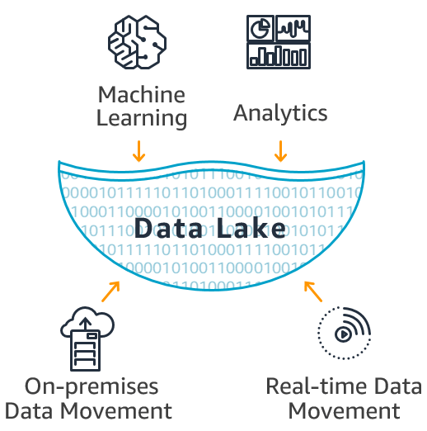
What is a Data Lake
10,000 foot view
Notes:
At 10,000 foot view the high-level framework for building a data lake that show how analytics systems work with source and destination systems

Slide 4
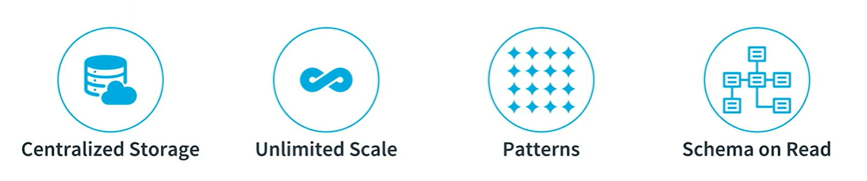
What is a Data Lake
5000 foot view

Slide 5
Components of Data Lake
Data Storage : Centralized data storage is compatible with file systems supported by Apache Spark like HDFS, AWS S3. Normally under open format like parquet, ORC ... for storing data, providing efficient compression and encoding schemes.
Data Ingestion: the first checkpoint when data in it native format enter to the data lake that ingested from various external sources such as files, applications, APIs, and streaming platforms ...
Data Processing: data layer where executes data processing tasks that include data cleansing, denormalization, and consolidation of different objects.
Data Serving: data stored in files or tables and makes it accessible and ready for consumption that ready for analysis and insights generation.
Data Catalog: the metadata repository that known as data about data is used to manage the data in the data lake. Governace and Security: controlling over data quality, acurate and compliance also provides centrally manage and scale fine-grained data access permissions.

Slide 6
Data Lake vs Data Warehouse
Data lakes and data warehouses are similar in that they both store and process data, each have their own specialties, and therefore their own use cases. That's why it's common for an enterprise-level organization to include a data lake and a data warehouse in their analytics ecosystem. what's the difference between a data lake and a data warehouse? And when is it appropriate to use one over the other?

Slide 7
Data Warehouse
Data Lake
Only relational, structured data
Data required for analytics is kept, since data warehouse costs are high
ETL (Extract, Transform, Load) process
Schema is On-Write
Optimize for Query performance
Highly curated data
Reporting, BI and visualization
Store any type of data-raw, structured, and semi-structured
Petabytes of data can be stored for very long periods since storage costs are low
ELT (Extract, Load Transform) process
Schema is On-Read
Data storage and processing flexibility
Data curated or may not ( raw data)
Machine Learning, prrdictive analytics, data discovery and profiling
Udacity IPS Ver. 1 2/2020

Slide 8
Business Value of Data Lake
The data lake architecture solves the scalability issues with the current SQL server. This is due to the fact that data lake is a distributed object storage in nature and can scale easily. Amazon S3 can meet company’s demands at any scale.
Data anlytics workloads will not be a problem that cloud-based solution such as Hive, Redshift, Athena can be used to directly read data from the data lake in a distributed manner that automatically and elastically scales query processing power. So that we don’t need to run batch processing in nightly anymore.
This architecture addresses data silo and duplication issues. Enabling business innovation by allow downstream consumer can discovery much as much any of data aspects.
Data Lake can be a good enabler of machine learning, artifical inteligence and big data as it offers a scalable storage that is distributed in nature.

Slide 9
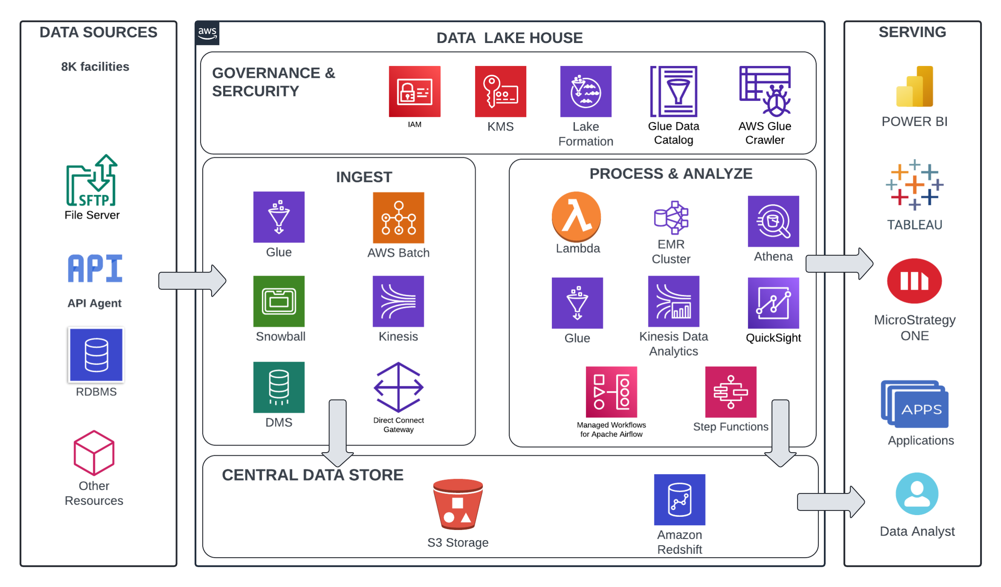
Data Lake Architecture

Slide 10
THANK YOU
Udacity IPS Version 1.0

